Slide 1
WELCOME TO
ENGLISH 1st PAPER CLASS

Slide 2
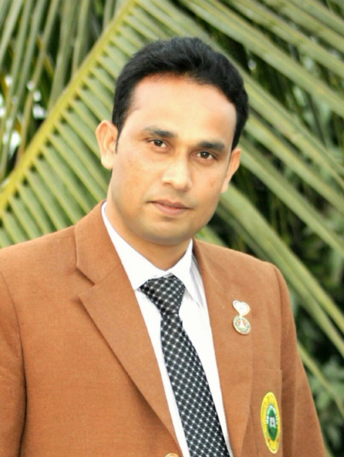
Identity
Amzad Hossin Shovon
Assistant Teacher
Matidali High School, Bogura.
Email: shovonamzad@gmail.com
Mobile: 01723945494

Slide 3
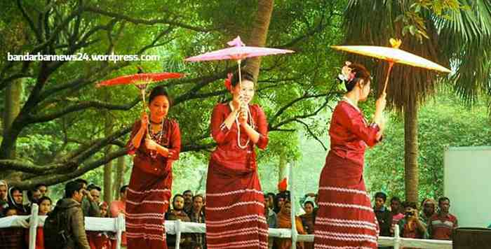
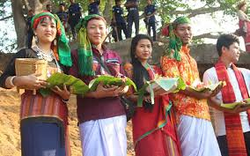
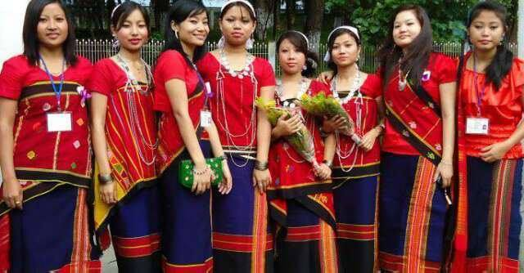
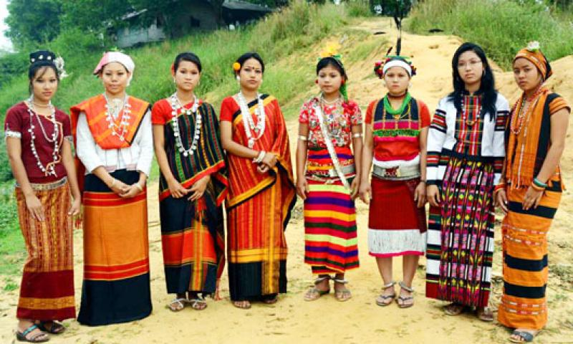
LOOK AT THE PICTURES
Garos
Chakma
Khasias
Marma

Slide 4
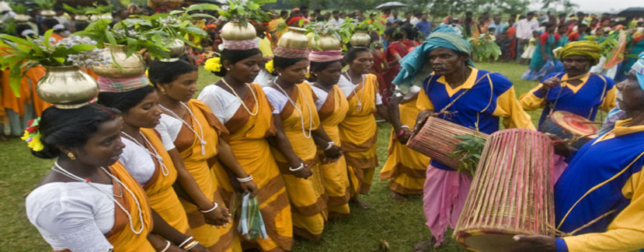
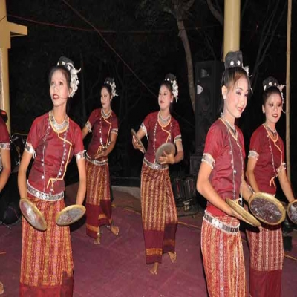
LOOK AT THE PICTURES
Sawtal
Tripura
WHO ARE THEY?

Slide 5
TODAY’S TOPIC
Class: Eight
Unit: One
Lesson: 3&4
our ethnic friends

Slide 6
LEARNING OUTCOMES
By the end of the lesson the learners will be able to-----
 describe the ethnic people.
guess meaning of the words close to the text.
 write the activities of the ethnic people.

Slide 7
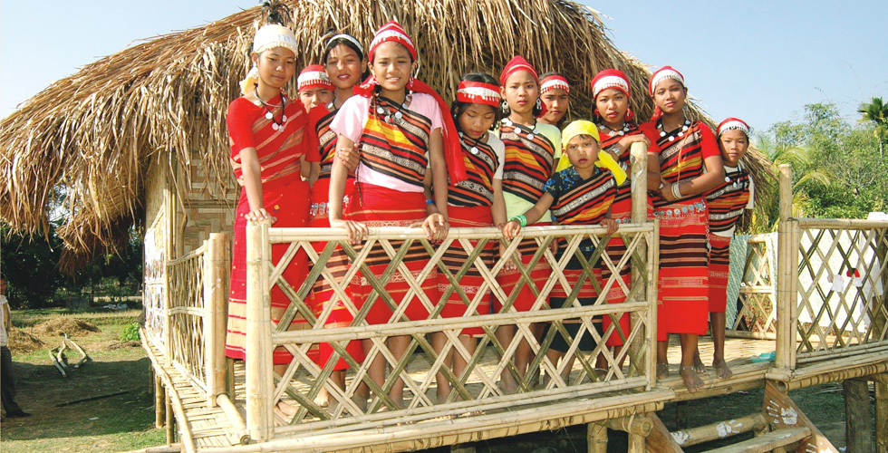
Look the picture and read the text below
The majority of the ethnic people live in the Chittagong Hill Tracts. The others live in the regions of Mymensingh, Rajshahi and Sylhet.

Slide 8
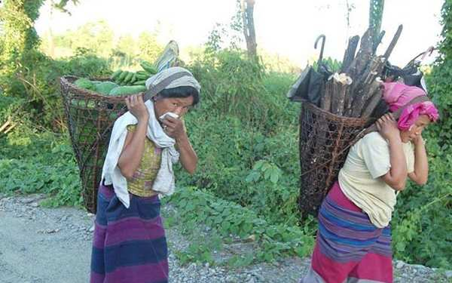
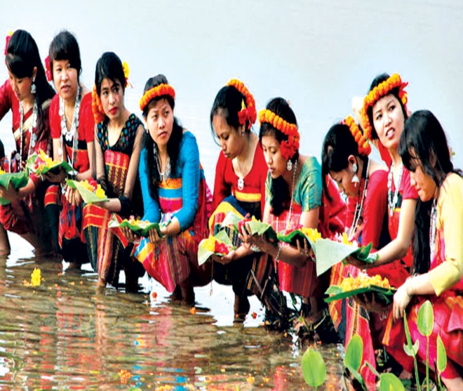
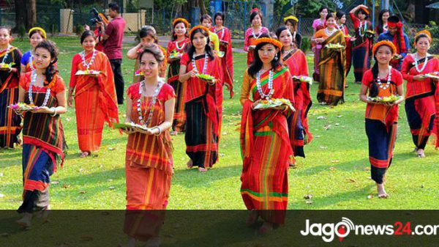
Look the picture and read the text below
Chakmas
Marmans
Tipperas
The Chakmas, The Marmans, The Tipperas and the Moorans are live in the Hill Tracts. By religion they are Hindus, Christians or Buddhists.
Moorangs

Slide 9
Look the picture and read the text below
Khasias
The Santals live in Rajshahi. The Khasias and Monipuries live in Sylhet. The Garos live in Mymensingh.
Santals

Slide 10
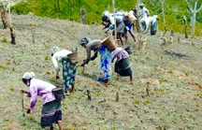
Jhum Cultivation
Clearing the hill –slopes and the lands in the forests, ethnic people practise cultivation and its called ‘jhum’.For this work they clear a piece of land in the forest , prepare it and sow seeds in it. Most of them are farmers.

Slide 11
Individual Work
5 minutes
Write the True or False. If false, give the correct answer.
Most of them are health worker.
They practice jhum cultivation.
The Garos are live in Rajshahi.
Most of them are Muslims and Yeahudis.
By religion all of them are Christians.

Slide 12
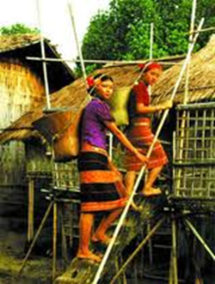
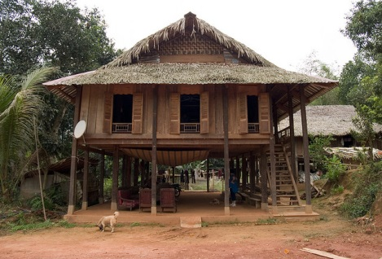
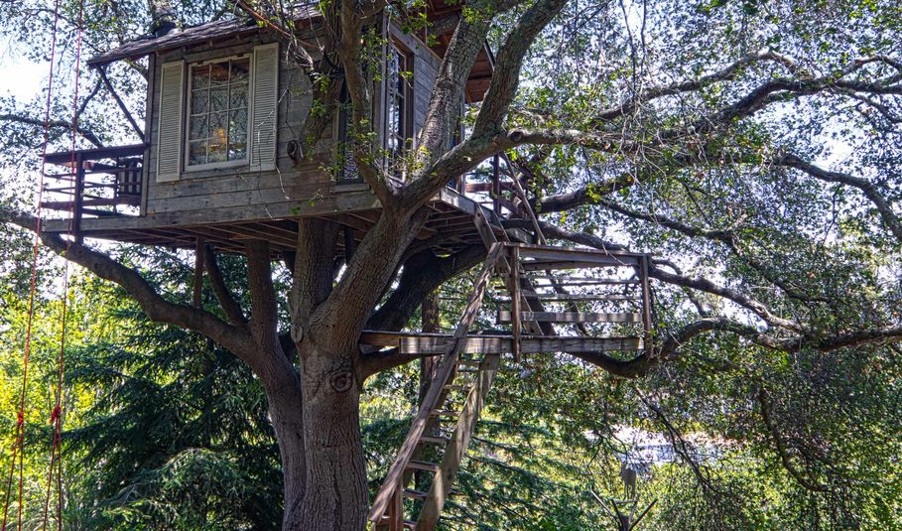
MACHANG
Ethnic people build their houses on the high platform that is called the ‘Machang.’
Ethnic people build their houses on the high platform to protect them from wild animals.

Slide 13
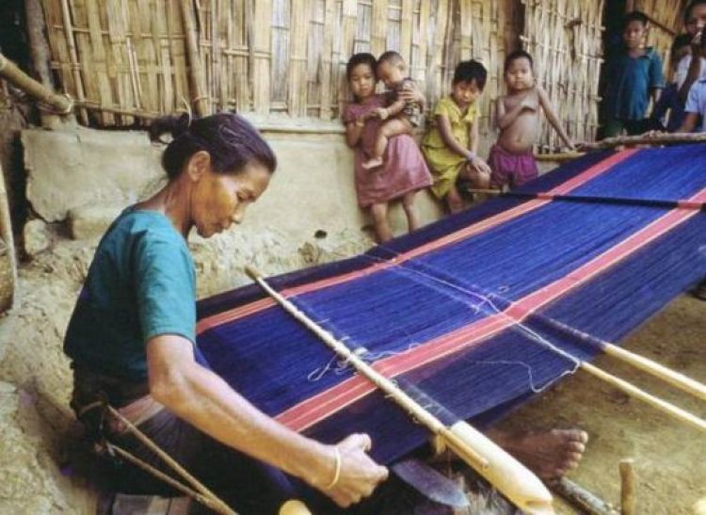
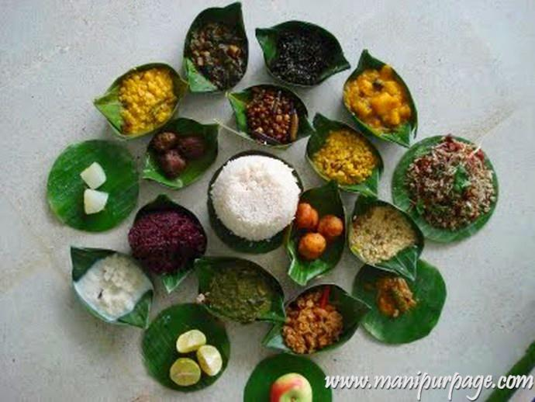
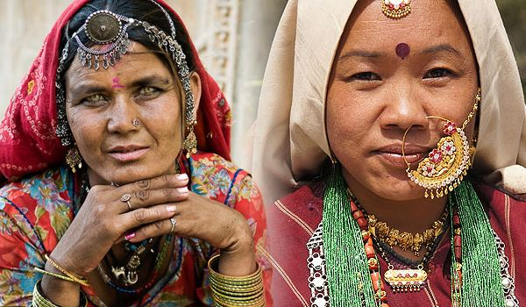
SOME COMMON CHARACTERISTICS OF ETHNIC PEOPLE
JHUM -
AGRICULTURE
HUNTING
MACHANG
WEAVING
FOOD- RICE WITH VEGETABLES
HEAVY JUELLERY

Slide 14
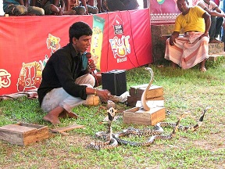
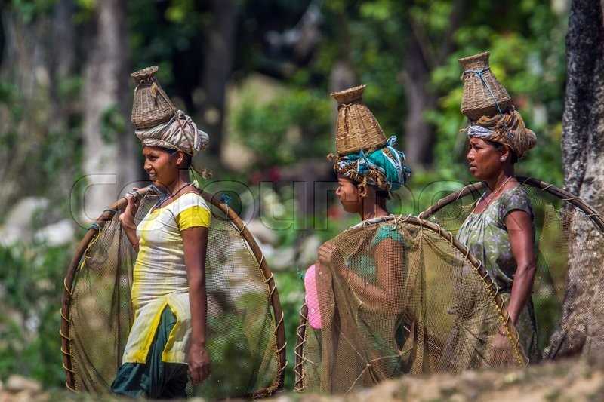
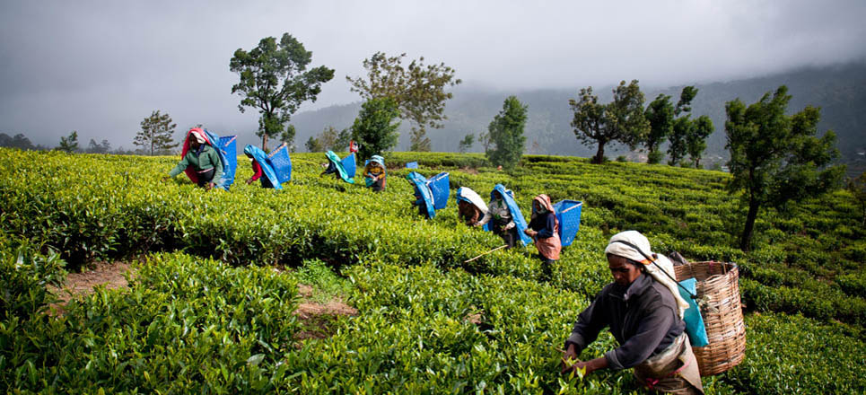
SNAKE CHARMING
HUNTING
FISHING
Occupation
TEA LABOURING
JHUM CULTIVATION

Slide 15
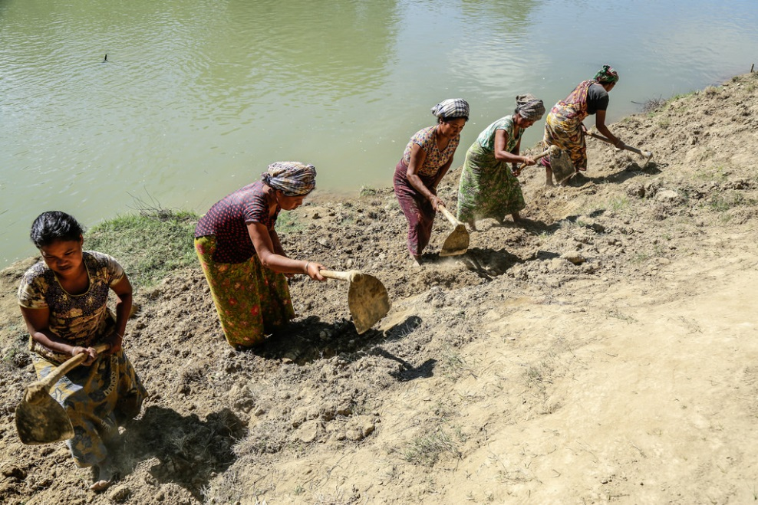
Pair Work
Answer the following two question with discuss your partner
1. Where and how do they do the Jhum cultivation?

Slide 16
Evaluation
Fill in the gaps using the words bellow. There are more words than necessary.
Lungi, sport, earthen, machang, weave, wrestling, song, rice, fishing, lifestyles, wooden, bugle.
Cheak your answer
The tribal people follow their(a)---------. The platform they build their houses on is called(b)----------. Men wear(c)------. Women(d)--------their own clothes. Their staple food is
(e) -----. They are fond of songs, dance, music and(f) --------.
(g)--------------- is their favourite sport.
lifestyles
machang
lungi
weave
rice
sport
wrestling

Slide 17
MCQ
ITEMS
1.Guess the meaning of the following words close to the text:
i) ethnic-
iii) platform-
a)people living in the forest areas ,
distinct in culture, religious and language-tribes
a) station
b) root people’s subordinate
d) stage
c)rural people
c) track
d)People living in the low lying areas
b)raised surface to build houses
ii) tongue-
iv) characteristic-
a)language
c)utterance
a)feature
c) look
b)speech
d)word
b)type
d)quality

Slide 18
Answer the following question the next day.
1. What does the term ‘ethnic’ mean?
2. What is ‘MACHANG’?
3. Why do they build their houses on the high platform?
4.What are their occupations? What do the most people do?
5. How do they do the JHUM CULTIVATION ?

Slide 19
Thank you

